Slide 1
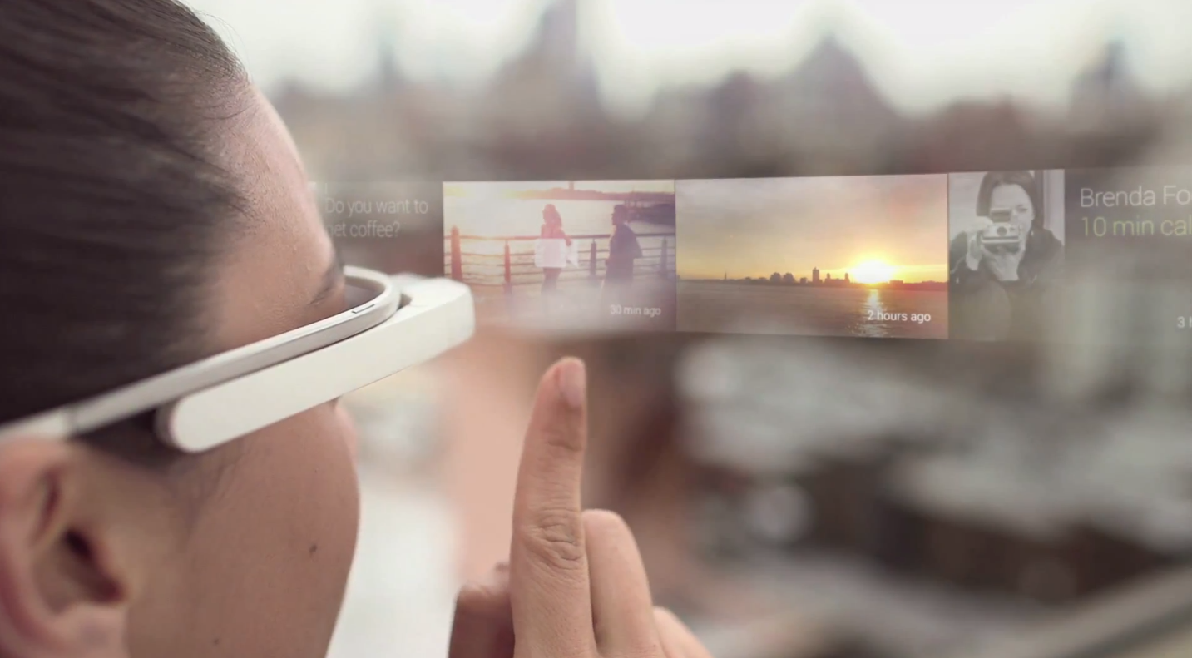
Adding Voice Commands to Google Glass
https://github.com/lnanek
/GoogleGlassVoiceCommands

Slide 2

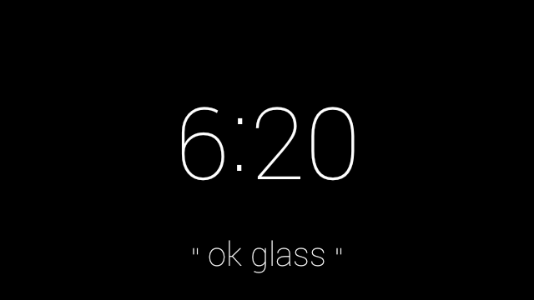
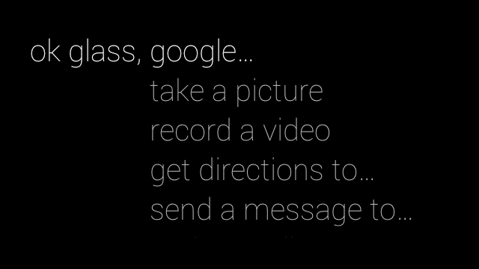
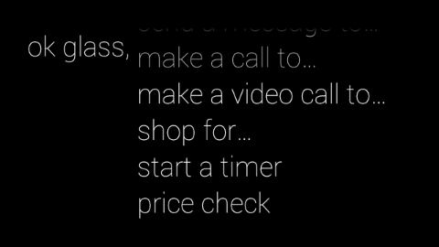
OK Glass Menu

Slide 3
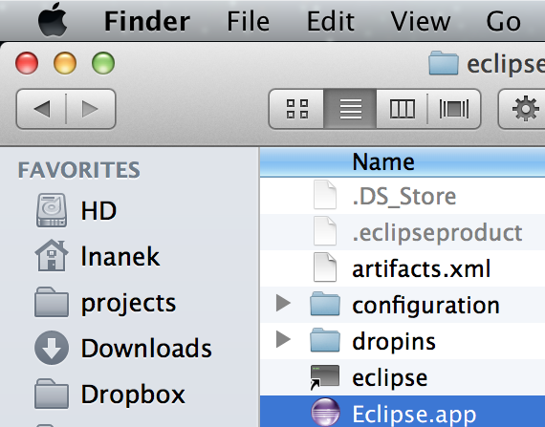
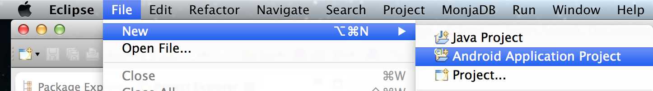
Create an Android App http://developer.android.com/sdk/

Slide 4
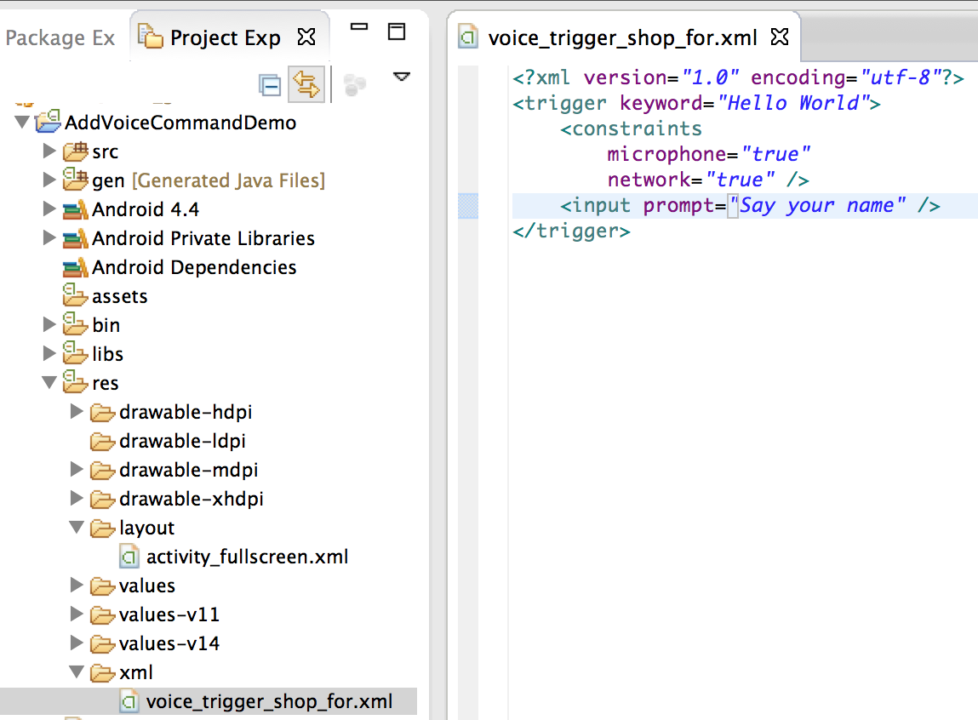
Add XML File for Each Voice Trigger

Slide 5
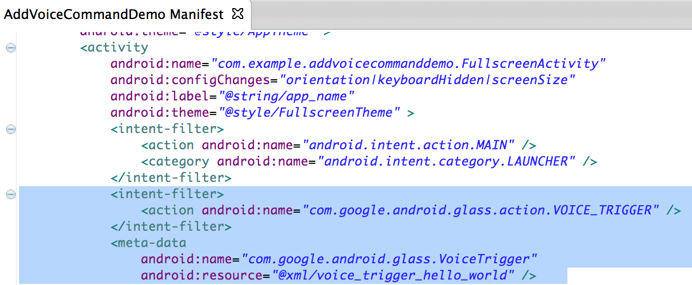
Reference in AndroidManifest.xml

Slide 6
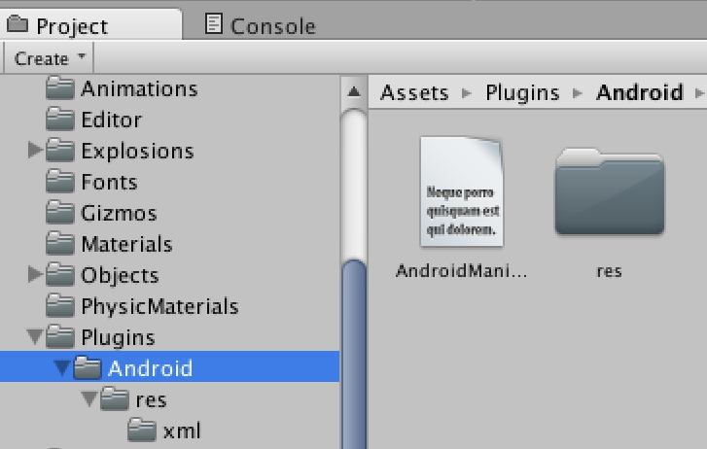
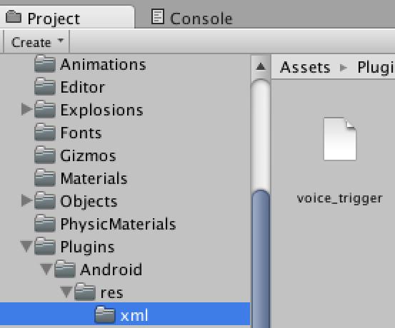
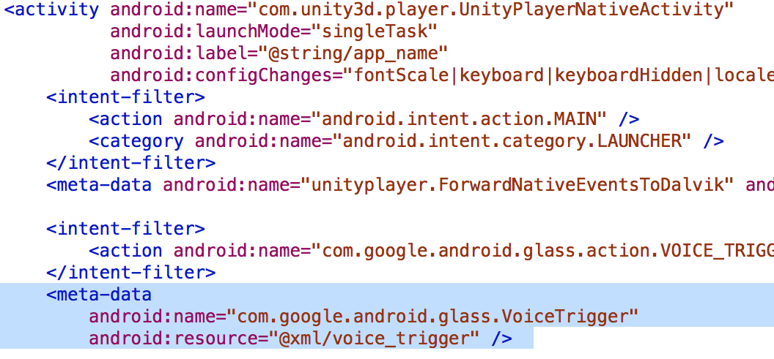
Bonus: Starting a Unity App

Slide 7
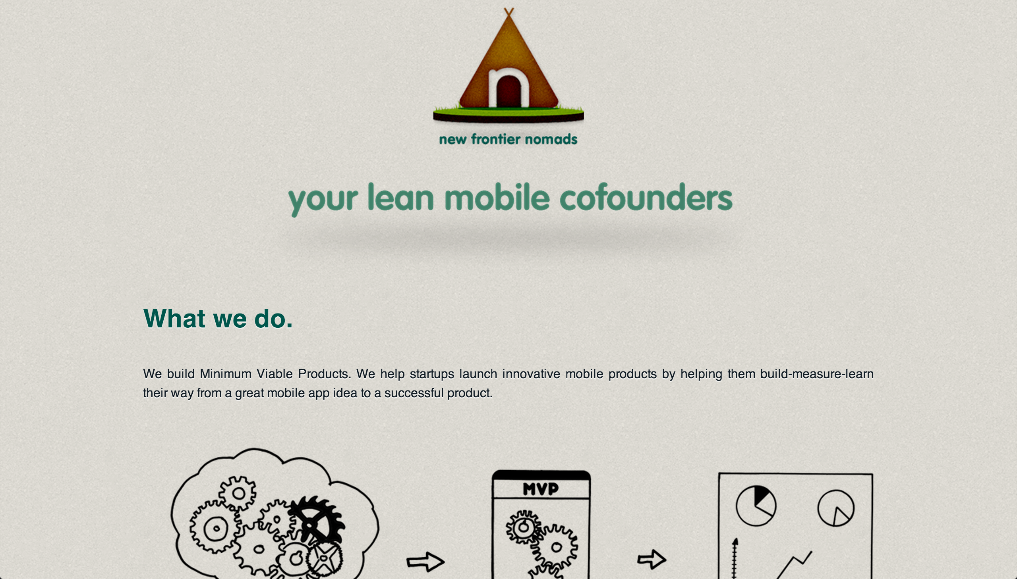
New Frontier Nomads http://newfrontiernomads.com/

